Slide 1

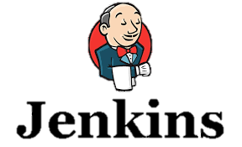




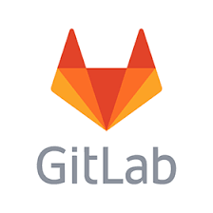




IBM Dependency Based Build (DBB) - Nutshell
IBM Dependency Based Build (DBB) - Intelligent build environment for applications stored in Git (or “any other” SCM)
Groovy driven build environment for compiling, linking and processing z/OS programs and applications
Dependency identification and understanding
Automatically identify program dependencies , build intelligently based on dependencies
Integration with any CI tooling (e.g. Jenkins)
Provides User Build integration with ZOD / IBM Developer for System z (IDzEE)
DBB Liberty App
Dependency Data
Build Results
Start Pipeline
Status, logs and links to reports
Git server
DBB Toolkit
USS
PDS
Main Repository
Agent
Groovy Build scripts
(scan, impact analysis, copy to PDS, compile, link-edit, bind, report)
CLONE to USS

Slide 2


DBB Build Scenarios
Here are 2 scenarios to explain how DBB works when a change is made to a sample application of, lets say, 3 programs and 3 copybooks.
Sample DBB Tool Kit Java APIs
If we change CYP-2, DBB will return a build-list of “PGMS A,B,C“ and their dependent copybooks “CPY1,2,3”.
CopyToPDS - e.g., copy src to MVS
CopyToHFS - e.g., copy sysout to USS
MVSEXEC - execute a pgm like a Compiler
DDstatement – Dynamically alloc a Data set
If we change PGM-B, DBB will return “PGMS B & C” and Copybooks “2 &3”.
Sample application and related dependencies
DBB Result - Build List
PGM-A
CPY-1
CPY-1
Scenarios
Sample Groovy Script - EXEC PGM
PGM-B
CPY-2
PGM-A
def delete = new MVSExec().pgm("IEFBR14")
def oldDS = new DDStatement() oldDS.setName("OLDDS") oldDS.setDsn("USR1.BUILD.COBOL") oldDS.setOptions("old delete")
delete.addDDStatment(oldDS)
int rc = delete.execute()
CPY-2
CPY-3
PGM-C
Change CPY-2
PGM-B
CPY-3
PGM-B
CPY-2
PGM-C
Change PGM-B
Static Link
PGM-C
CPY-3

